Slide 1


UNIVERSITÀ DEGLI STUDI DI MILANO-BICOCCA
MSC IN DATA SCIENCE
A.Y. 2024-2025
Classifying images
using a CNN
Course in Foundation of Deep Learning
By Salvatore Marcello, Biagio Spiezia

Slide 2

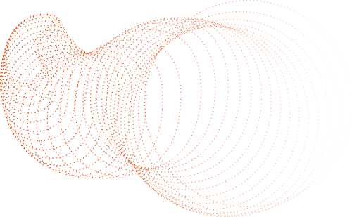
UNIVERSITÀ DEGLI STUDI DI MILANO-BICOCCA
MSC IN DATA SCIENCE
A.Y. 2024-2025
TEAM
PRESENTATION
SALVATORE MARCELLO
766047
BIAGIO SPIEZIA
920172

Slide 3

UNIVERSITÀ DEGLI STUDI DI MILANO-BICOCCA
MSC IN DATA SCIENCE
A.Y. 2024-2025
Aim of the project
The photo are divided into ten categories:
airplane
automobile
bird
cat
deer
Given a set of 10.000 images, the aim is to predict the category of objects to which each photo belongs.
dog
frog
horse
ship
truck

Slide 4
UNIVERSITÀ DEGLI STUDI DI MILANO-BICOCCA
MSC IN DATA SCIENCE
A.Y. 2024-2025
CIFAR-10 Dataset
The CIFAR-10 dataset contains 50.000 images in the training set and 10.000 images in the test set.
All images are in color, with dimensions of 32x32 pixels and 3 RGB channels. Each image is also accompanied by a label that identifies the object.

Slide 5

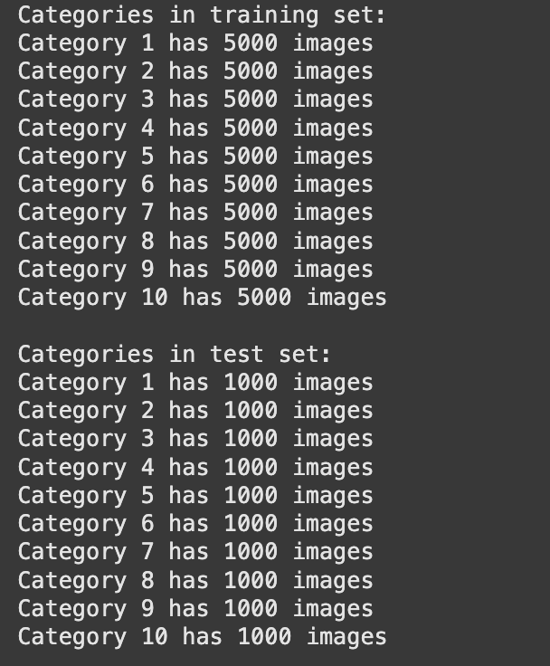
UNIVERSITÀ DEGLI STUDI DI MILANO-BICOCCA
MSC IN DATA SCIENCE
A.Y. 2024-2025
A QUICK OVERVIEW
There are the same number of photos for each category, both in the train and test sets. The training set contains 5,000 images per category, while the test set includes 1,000 images per category.

Slide 6

UNIVERSITÀ DEGLI STUDI DI MILANO-BICOCCA
MSC IN DATA SCIENCE
A.Y. 2024-2025
NORMALISATION AND DATA PREPROCESSING
ADDITIONALLY, THE CATEGORICAL LABELS ARE TRANSFORMED INTO ONE-HOT ENCODED VECTORS. FOR INSTANCE, THE LABEL CORRESPONDING TO THE FIRST CLASS BECOMES: [1, 0, 0, 0, 0, 0, 0, 0, 0, 0].
THIS PREPROCESSING STEP IS CRUCIAL BECAUSE NEURAL NETWORKS TEND TO PERFORM MORE EFFICIENTLY AND CONVERGE FASTER WHEN THE INPUT VALUES ARE SCALED TO A SMALLER RANGE.
BOTH THE TRAINING AND TEST DATASETS ARE CONVERTED TO FLOAT32 FORMAT AND NORMALIZED BY DIVIDING EACH PIXEL VALUE BY 255 — THE MAXIMUM POSSIBLE PIXEL INTENSITY. AS A RESULT, THE PIXEL VALUES NOW RANGE BETWEEN 0 AND 1.
TORNA AL PROGRAMMA

Slide 7
UNIVERSITÀ DEGLI STUDI DI MILANO-BICOCCA
MSC IN DATA SCIENCE
A.Y. 2024-2025
1
2
3
4
CONV2D+
MAXPOOLING2D
+ ANOTHER
LAYER
+ DROPOUT
+ REGULARIZATION

Slide 8



UNIVERSITÀ DEGLI STUDI DI MILANO-BICOCCA
MSC IN DATA SCIENCE
FIRST MODEL
A.Y. 2024-2025
LAYER | PARAMETER | OUTPUT SHAPE
CONV2D | 32, 3x3, ReLU | (30, 30, 32)
CONV2D | 32, 3x3, ReLU | (28, 28, 32)
MAXPOOLING | 2x2 | (14, 14, 32)
FLATTEN | - | (6272,)
DENSE | 128, ReLU | (128,)
DENSE | 10, Softmax | (10,)
ACCURACY: 62.31%
LOSS: 450.53%
SHALLOW MODEL,
OVERFITTING RISK,
LOW GENERALIZATION

Slide 9
UNIVERSITÀ DEGLI STUDI DI MILANO-BICOCCA
MSC IN DATA SCIENCE
A.Y. 2024-2025
SECOND MODEL
ADDITIONAL LAYER
+ Conv2D (64 filters)
+ MaxPooling2D
ACCURACY: 69.89%
LOSS: 286.76%
DEEPER MODEL
GREATER LEARNING OF COMPLEX PATTERNS

Slide 10
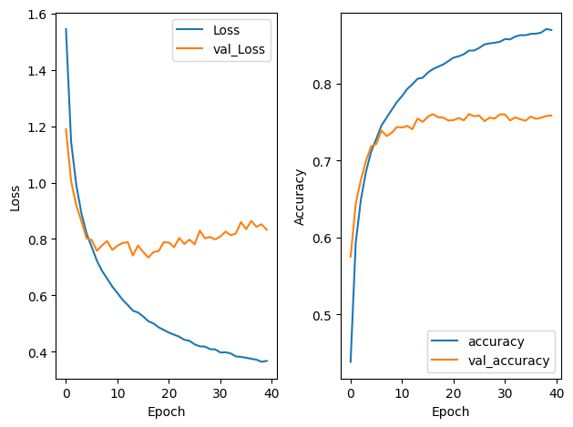
UNIVERSITÀ DEGLI STUDI DI MILANO-BICOCCA
MSC IN DATA SCIENCE
A.Y. 2024-2025
THIRD MODEL
ACCURACY: 75.83%
LOSS: 83.28%
SAME STRUCTURE BUT USE DROPOUT AFTER EACH MAXPOOLING
GOAL
REDUCE OVERFITTING
TRAINING LOSS CONTINUES TO DECREASE, WHILE VALIDATION LOSS STABILIZES: A SIGN THAT DROPOUT IS HELPING TO CONTAIN OVERFITTING. ACCURACY IN VALIDATION REMAINS STEADY AT AROUND 76%.

Slide 11

UNIVERSITÀ DEGLI STUDI DI MILANO-BICOCCA
MSC IN DATA SCIENCE
A.Y. 2024-2025
FOURTH MODEL
ADDITIONAL IMPROVEMENTS
+Kernel regularizer L2
+ Conv2D Layers : up to 256 filters
+ GlobalAveragePooling2D
+Final Dense Layer
ACCURACY: 80.50%
LOSS: 75.71%
L2 PENALIZES EXCESSIVELY LARGE WEIGHTS
HELPS AVOID OVERFITTING

Slide 12
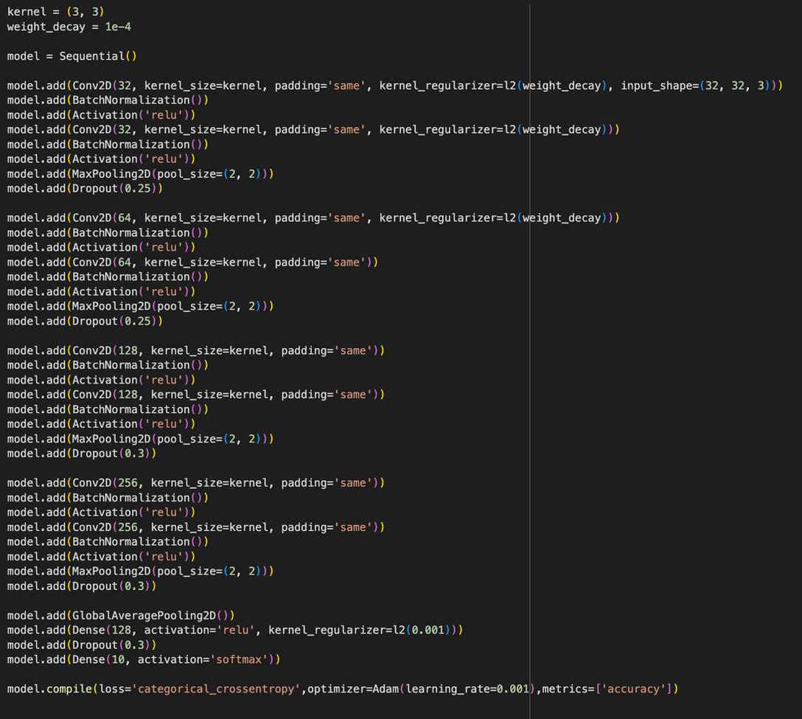
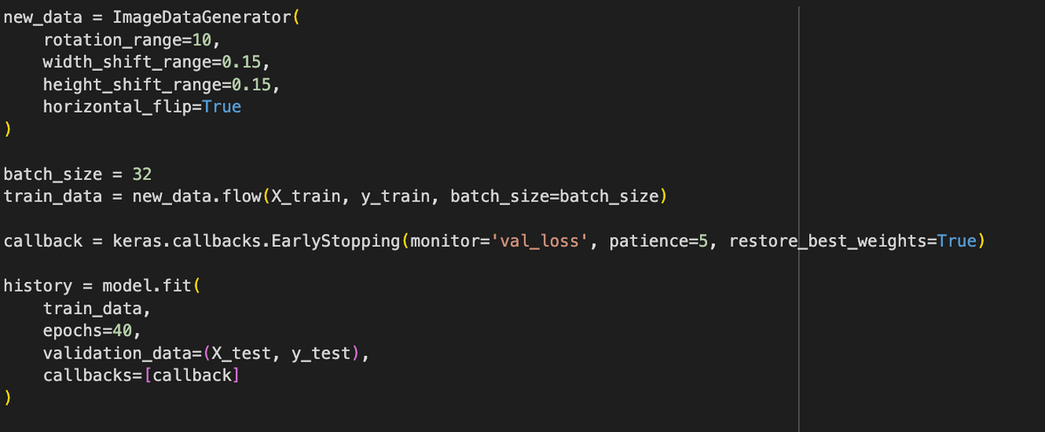
UNIVERSITÀ DEGLI STUDI DI MILANO-BICOCCA
MSC IN DATA SCIENCE
FINAL MODEL BEFORE FINE-TUNING
A.Y. 2024-2025

Slide 13

UNIVERSITÀ DEGLI STUDI DI MILANO-BICOCCA
MSC IN DATA SCIENCE
A.Y. 2024-2025
IMPROVEMENTS
Batch Normalization | After every layer
Data Augmentation | ImageDataGenerator: rotation , shift, flip
EarlyStopping | In order to avoid overfitting
ACCURACY: 84.08%
LOSS: 53.24%
THE MODEL’S PERFORMANCE INCREASED BY ADDING EACHI OF THIS TECNIQUE MORE OF +22% ACCURACY AND REDUCED LOSS.
✅ INCREASED DEPTH
✅ DROPOUT AND L2
✅ BATCH NORMALIZATION
✅ DATA AUGMENTATION
✅ EARLY STOPPING

Slide 14
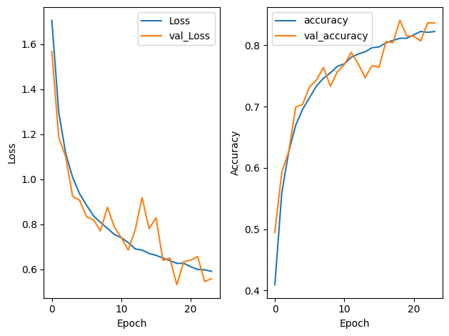
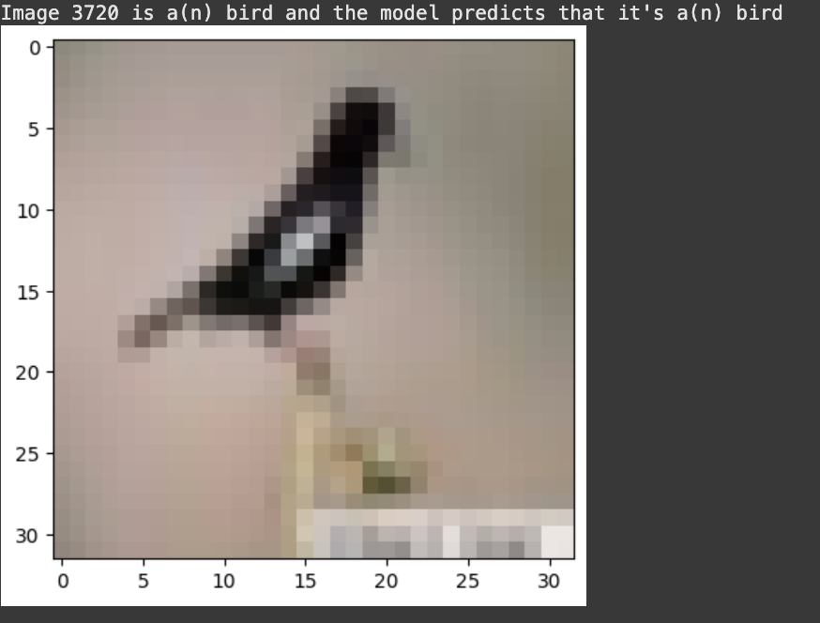

UNIVERSITÀ DEGLI STUDI DI MILANO-BICOCCA
MSC IN DATA SCIENCE
A.Y. 2024-2025

Slide 15
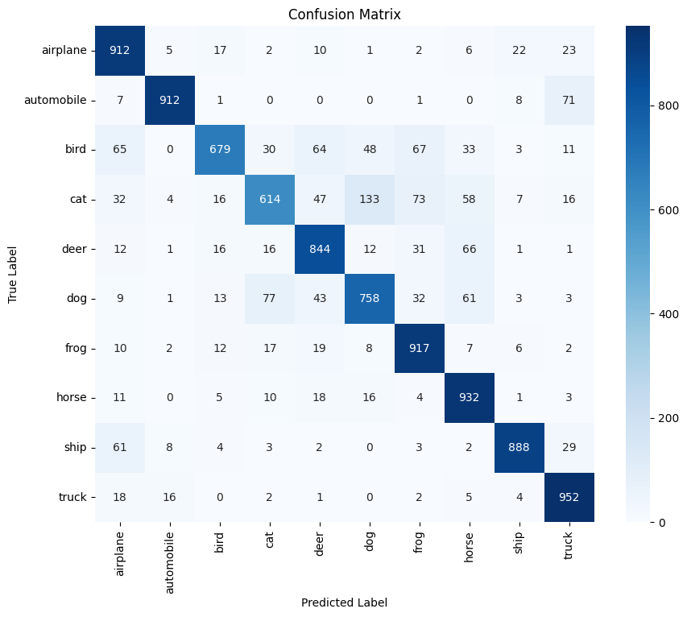
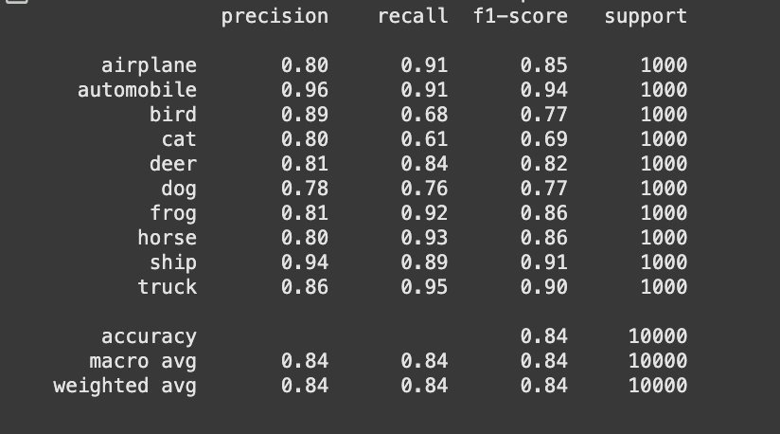

UNIVERSITÀ DEGLI STUDI DI MILANO-BICOCCA
MSC IN DATA SCIENCE
A.Y. 2024-2025

Slide 16
UNIVERSITÀ DEGLI STUDI DI MILANO-BICOCCA
MSC IN DATA SCIENCE
A.Y. 2024-2025
FINE TUNED MODEL
TRANSFER LEARNING BASED ON RESNET50
ADVANCED DATA AUGMENTATION
TWO-PHASE TRAINING
DYNAMIC LEARNING RATE
IMAGES ARE RESIZED TO 224X224 PIXELS FOR RESNET50 COMPATIBILITY

Slide 17
UNIVERSITÀ DEGLI STUDI DI MILANO-BICOCCA
MSC IN DATA SCIENCE
A.Y. 2024-2025
NEW DATA AUGMENTATION TECHNIQUES
NEW DATA AUGMENTATION TECHNIQUES:
PREVENTS THE MODEL FROM RELYING ON OBJECT-TO-FRAME SIZE RATIOS.
RANDOMCONTRAST: MAKES THE MODEL MORE ROBUST TO VARIATIONS IN LIGHTING AND IMAGE QUALITY.
CUTMIX: FORCES THE MODEL TO RECOGNIZE OBJECTS EVEN WHEN THEY ARE PARTIALLY OCCLUDED, IMPROVING FEATURE LOCALIZATION AND ROBUSTNESS.

Slide 18
UNIVERSITÀ DEGLI STUDI DI MILANO-BICOCCA
MSC IN DATA SCIENCE
A.Y. 2024-2025
TWO PHASES FINE TUNING STRATEGY
PHASE 1: TRAIN CLASSIFIER HEAD
Train only the new top layers on CIFAR-10 features.
Freeze the ResNet50 base (trainable = False) to prevent weight updates.
Establishes a strong baseline without disrupting pre-trained knowledge.
PHASE 2: FULL NETWORK SPECIALIZATION
SLIGHTLY ADJUST THE WEIGHTS OF THE ENTIRE NETWORK, INCLUDING THE RESNET50 BASE.
THE RESNET50 BASE IS UNFROZEN (TRAINABLE = TRUE), AND TRAINING RESUMES WITH A VERY LOW LEARNING RATE (1E-5).
ADAPT FOR THE SPECIFIC TASK, LEADING TO A SIGNIFICANT PERFORMANCE BOOST.

Slide 19
UNIVERSITÀ DEGLI STUDI DI MILANO-BICOCCA
MSC IN DATA SCIENCE
A.Y. 2024-2025
1
2
3
4
UPSCALING
DATA AUGMENTATION
FINE TUNING ONLY HEAD
FINE TUNING ALL NET WITH VERY LOW LEARNING RATE

Slide 20
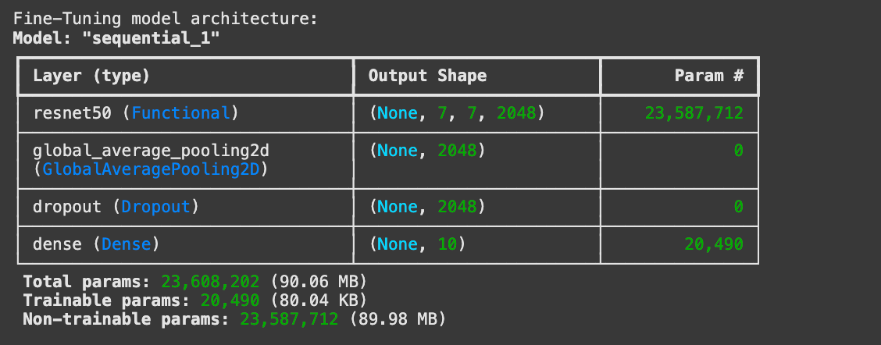
UNIVERSITÀ DEGLI STUDI DI MILANO-BICOCCA
MSC IN DATA SCIENCE
FINE-TUNING MODEL
A.Y. 2024-2025

Slide 21
UNIVERSITÀ DEGLI STUDI DI MILANO-BICOCCA
MSC IN DATA SCIENCE
A.Y. 2024-2025
IMPROVEMENTS
Upscaling
Data augmentation
Fine tuning only head
Fine tuning all net with very low learning rate
ACCURACY: 96.70%
LOSS: 15.18%

Slide 22
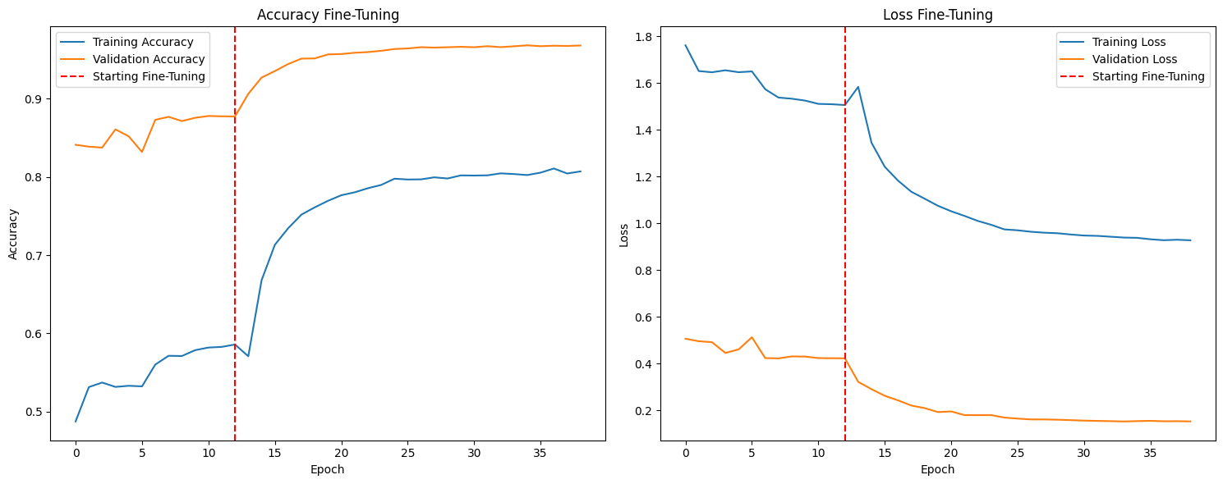
UNIVERSITÀ DEGLI STUDI DI MILANO-BICOCCA
MSC IN DATA SCIENCE
A.Y. 2024-2025

Slide 23
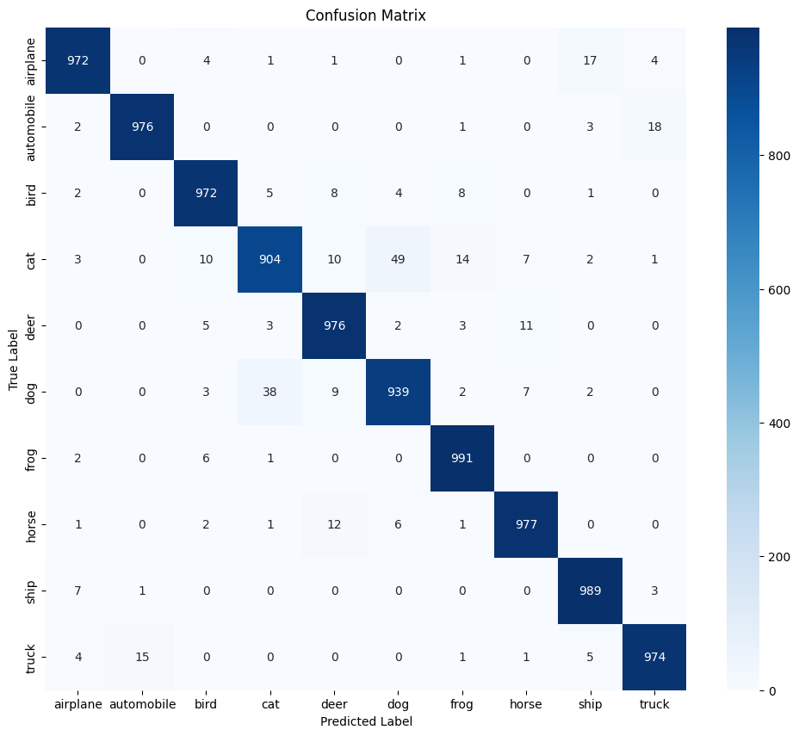
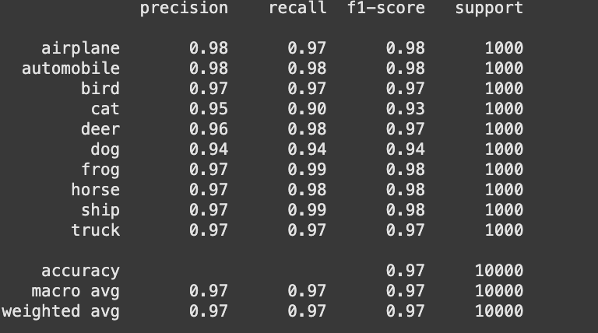
UNIVERSITÀ DEGLI STUDI DI MILANO-BICOCCA
MSC IN DATA SCIENCE
A.Y. 2024-2025

Slide 24

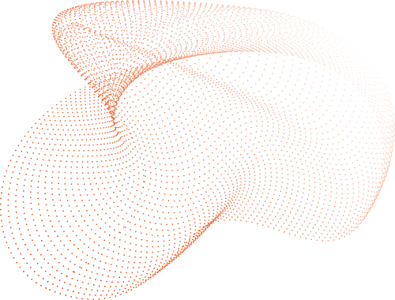


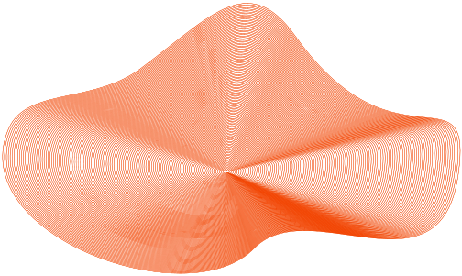
Many thanks for your attention !

